Slide 1
Youth On the Move: Transportation Advocacy & Mobility Management
December 2024
National Center for Mobility Management & Partners for Youth with Disabilities

Slide 2




nc4mm.org
Who We Are
Our Mission
A national technical assistance center funded through a cooperative agreement with the Federal Transit Administration and operated through a consortium of three national organizations
To promote customer-centered mobility strategies that advance good health, economic vitality, self-sufficiency, and community.
We work to promote cross-sector partnerships and help communities create/improve transportation options – “mobility management”
Notes:
For those that don't know me or the National Center for Mobility Management, I just wanted to briefly touch on the purpose of NCMM, its mission,
and how Mobility Management is helping to create connections within communities.
NCMM, founded in 2013, is a national technical assistance center funded through a cooperative agreement with the Federal Transit Administration
and operated through a consortium of three national organizations, which include, the American Public Transportation Association, the Community Transportation Association of American, and Easterseals.
The primary mission of NCMM is to promote customer centered mobility strategies that advance good health, economic vitality, self-sufficiency, and community.
The center works to promote cross-sector partnerships, and assists in supporting innovative and integrated transportation services by building capacity in communities and improving transportation options.
This includes: Planning and implementing grants, customized technical assistance, training for mobility management professionals,
facilitating collaboration among transportation and non-transportation organizations, and providing expertise on a number of various subjects related to mobility management.

Slide 3

NE
IA
KS
MO
KY
NC
TN
SC
MS
AL
GA
FL
NCMM Regional Liaison – Corresponding to
FTA Regional Offices 4 & 7
Region 4: Kentucky, Tennessee, Mississippi, Alabama, Georgia, Florida, North Carolina, South Carolina
Region 7: Missouri, Iowa, Nebraska, Kansas
Enjoli Dixon,
National Center for Mobility Management at Easterseals
Notes:
While I support FTA and HUD regions 4 and 7. I encourage you to reach out to us anytime- as we are both here to provide help with researching answers to your questions, facilitate community meetings, deliver trainings that inform your work, and provide other types of customized technical assistance.
So please contact me anytime at edixon@easterseals.com.

Slide 4
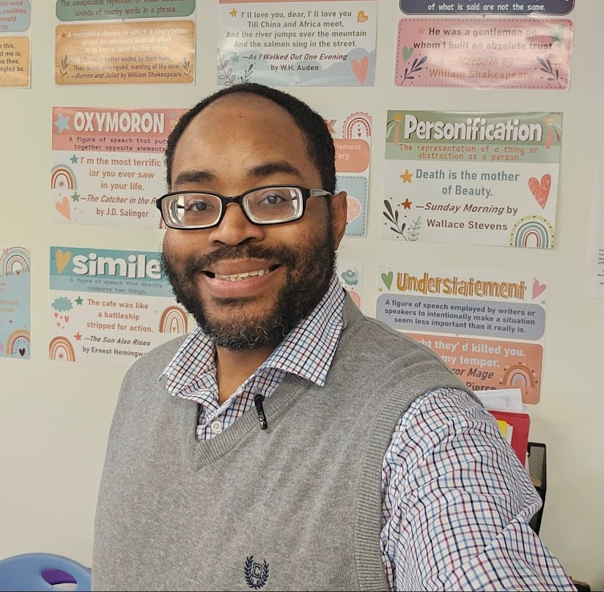
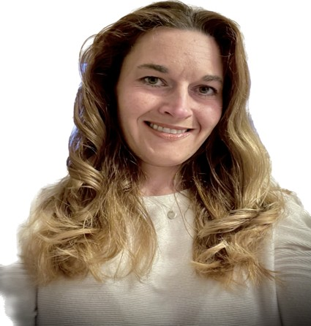
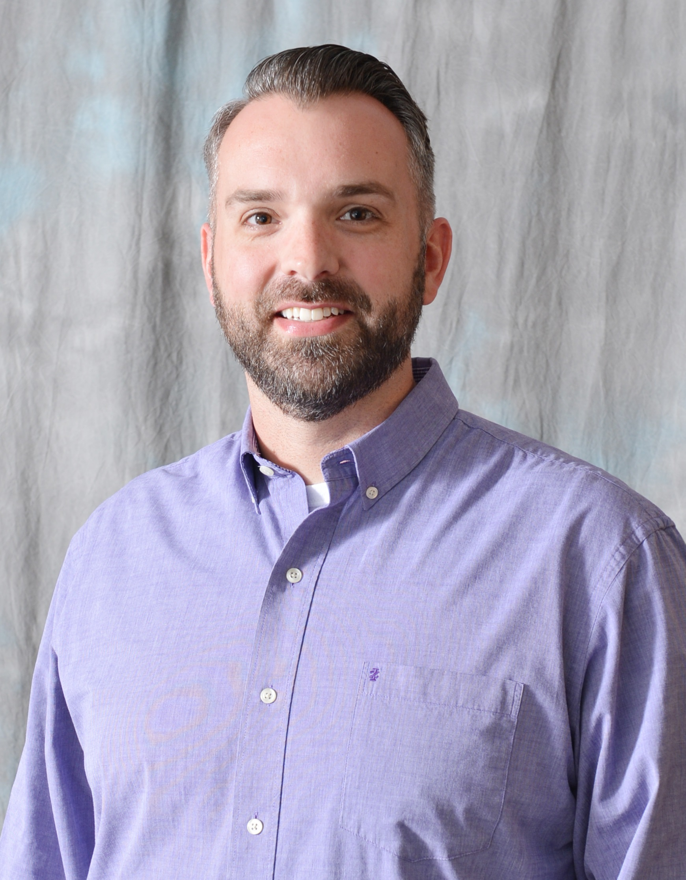
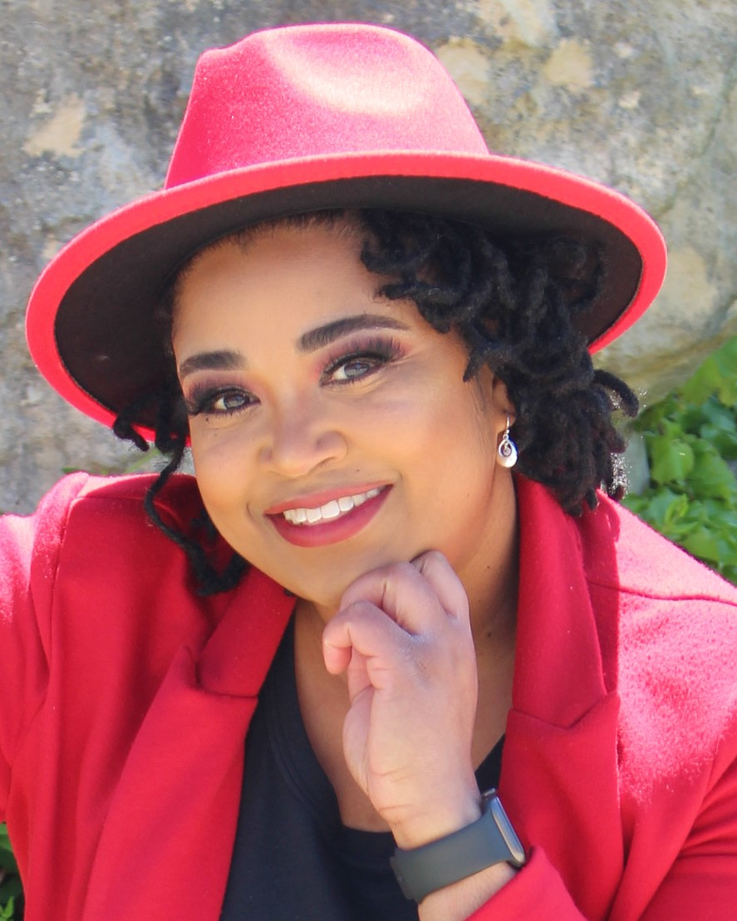

Transportation and Mobility, Accessibility Advisory Council (TMAAC)
Marcus McKnight
Yvonne Phillips
Jeremy Johnson-Miller
Raven Alexander

Slide 5
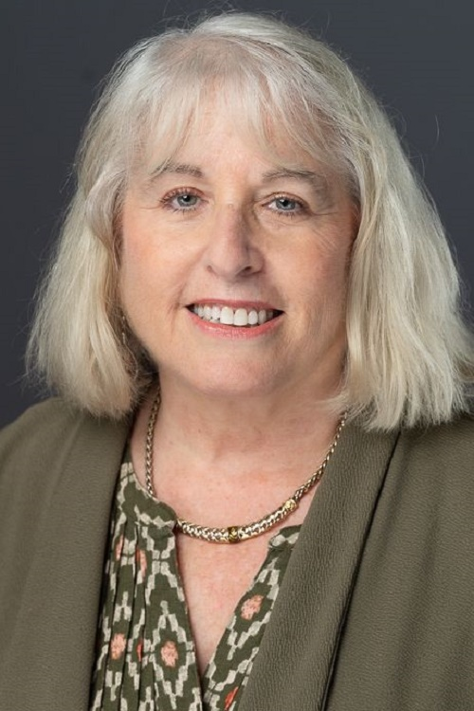
Easterseals National Director: Judy
Asst. Vice President, Education & Youth Transition
Partner Director for National Center for Mobility Management
Areas of Expertise: Coordination, Mobility Management, Research, Surveys and Data Collection, TA, Coalition Building and Facilitation.
Easterseals lead for two research projects funded by the National Science Foundation, Judy’s work focuses on conducting research to develop strategies to collect and utilize sidewalk accessibility data consistent with ADA requirements

Slide 6

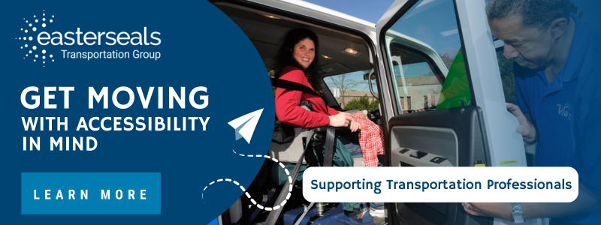

Slide 7
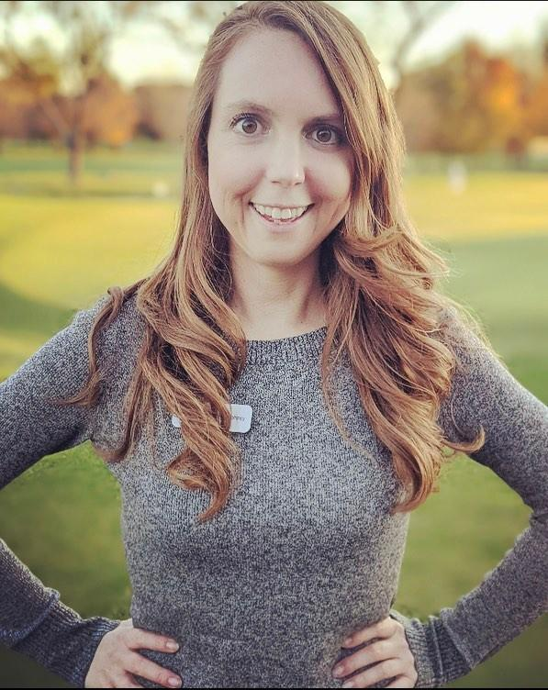
PYD Director: Kristin
17 years working with youth with disabilities
Oversees workforce inclusion training programs & National Disability Mentoring Coalition
Co-authored the manuscript, “Expanding Horizons: A Pilot Mentoring Program Linking College/Graduate Students and Teens with ASD,” published inJournal of Clinical Pediatrics in 2015
Co-authored the Inclusive Mentoring for Youth with Disabilities Supplement to the Elements of Effective Practice for Mentoring, published by MENTOR January 2023

Slide 8


Slide 9
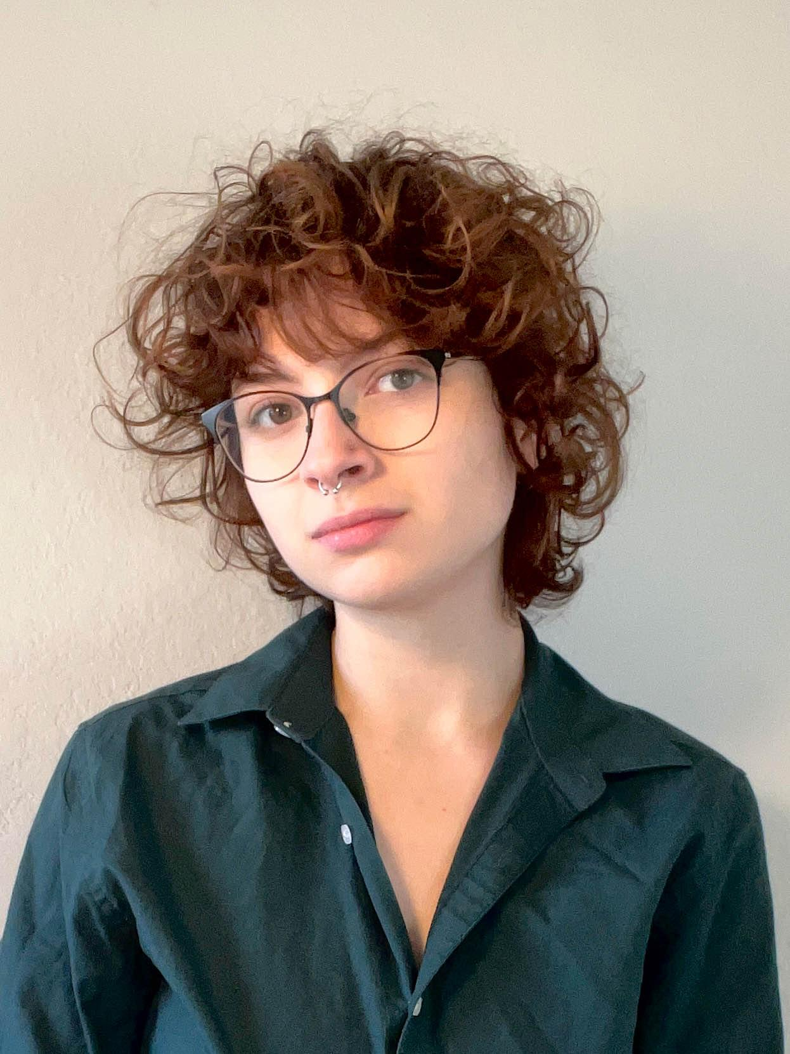
Speakers: Kaz
Third year undergraduate at The University of Texas at Austin studying International Relations and Critical Disability Studies
Current Transportation Fellow at Partners for Youth with Disabilities
Involved in school and local disability education and advocacy since 2021, including an in-progress project to require sun covers and benches at all Austin bus stops

Slide 10
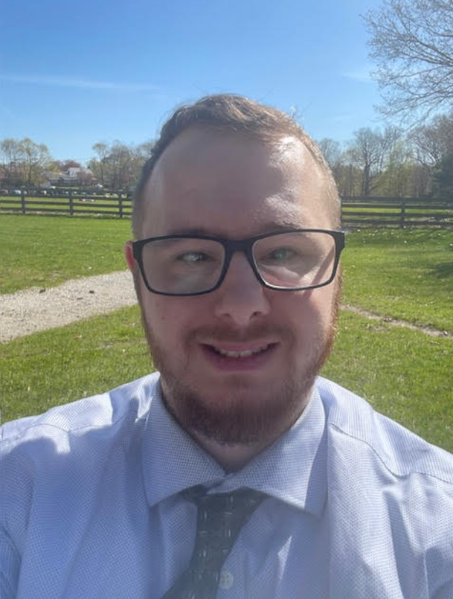
Speakers: Aaron
Disability Peer Advocate at the Boston Center for Independent Living, assisting consumers of all ages, including transition aged youth achieve their Independent Living goals (housing, education, acquiring financial benefits, employment, etc.
Former Outreach Specialist at Partners for Youth with Disabilities where he facilitated training for new staff, executed community engagement events, and served as a mentor to disabled youths.
Manager of Volunteer Services and Accessibility Projects at Gore Place (a historic mansion and farm) where he led conference panels about digital accessibility, provided multisensory/tactile tours of exhibits to visitors, and assisted in the development of an overall accessibility plan for the museum.
Worked with MassCultural Council’s Universal Participation INitiative to bring people with lived experiences and cultural organization employees together to ensure programming is accessible to all.

Slide 11
Youth On the Move: Transportation Advocacy & Mobility Management
Collaboration between Partners for Youth with Disabilities and Easterseals
Transportation Advocacy Mentoring Initiative Implementation Guide to share mentoring strategies and success
Build upon success of TAMI Guide as foundation for mobility managers to create regional guides

Slide 12
Youth On the Move: Transportation Advocacy & Mobility Management
Today’s youth are tomorrow’s transit future
Encourage unique perspectives and provide early career readiness and self-advocacy skills
Barriers to transit access are barriers to transit advocacy
Mobility managers can reduce accessibility barriers to empower youth to become more active in transit planning

Slide 13
Youth On the Move: Transportation Advocacy & Mobility Management
September 2024 survey conducted by PYD and Easterseals
18 young adult respondents – many interested in becoming involved in transportation advocacy
Only one had had the opportunity to do so
Youth interest exists
The challenge? Transformation from interest to involvement

Slide 14
Youth On the Move: Transportation Advocacy & Mobility Management
Many programs to get youth involved in local advocacy and transit planning currently exist
Ex - Youth Leadership Institute, Maryland Transit Administration Youth Council, SEPTA Youth Advisory Council, Youth Leadership Forum for Students with Disabilities, etc
Mobility managers can replicate in own communities

Slide 15
Youth On the Move: Transportation Advocacy & Mobility Management
BARRIERS TO ENGAGEMENT
ACCESS
OUTREACH
Physical accessibility
Resource promotion
Many local and national avenues
Essential to increase engagement

Slide 16
Youth On the Move: Transportation Advocacy & Mobility Management
SOURCES OF OUTREACH
Parents and schools
Local government
Community hubs
Mentoring orgs
Canvassing
Social media

Slide 17
Strategies for Youth Engagement, continued
Social Media platform series (TikTok, Youtube, Threads, BlueSky Facebook, Twitter, Instagram) showing the day in the life of a person with a disability, routes they can take to major landmarks or frequently traveled spots
Travel training offerings for students alongside drivers ed courses
Tie into relevant coursework (transportation history, city planning, civics, STEAM, etc).
Livestream or digital campaign on elevator outages how these disruptions of traffic flow impact people’s lives (spending extra time navigating stations, making young workers late for their first jobs, etc.)
Art/metalworking/carpentry courses - create internal maps of stations that are accessible to blind/low vision students or provide additional context for student who find wayfinding difficult

Slide 18
Strategies for Youth Engagement, continued
Students write in (sit in/petition to local and state officials detailing personal accessibility issues (overcrowding, wayfinding lack of reliable transportation routes, audible signals, etc.)
Encourage youth to give feedback on performance to MBTA ambassadors or similar roles to improve training
Encourage participation in Ryder Transportation Access Groups and other civic grassroots organizations to speak truth to power
Engage youth in creating sensory map of each station and how noise, overcrowding and other sensory based issues can be improved

Slide 19
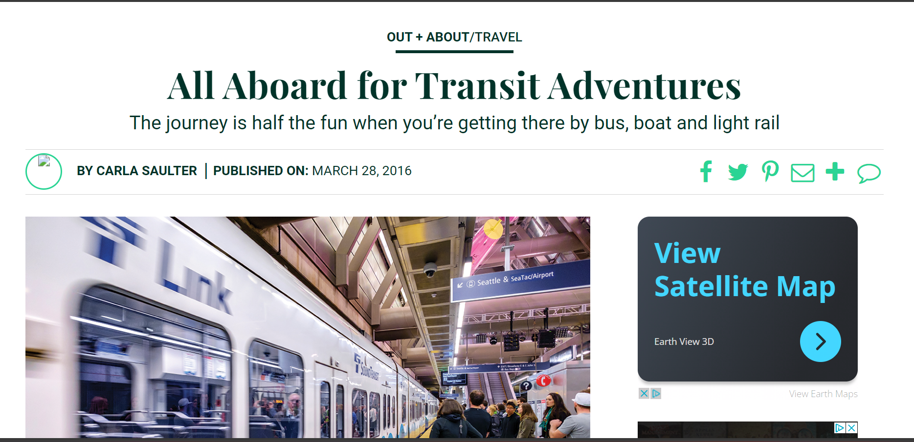
Strategies for Youth Engagement, continued
Examples:

Slide 20
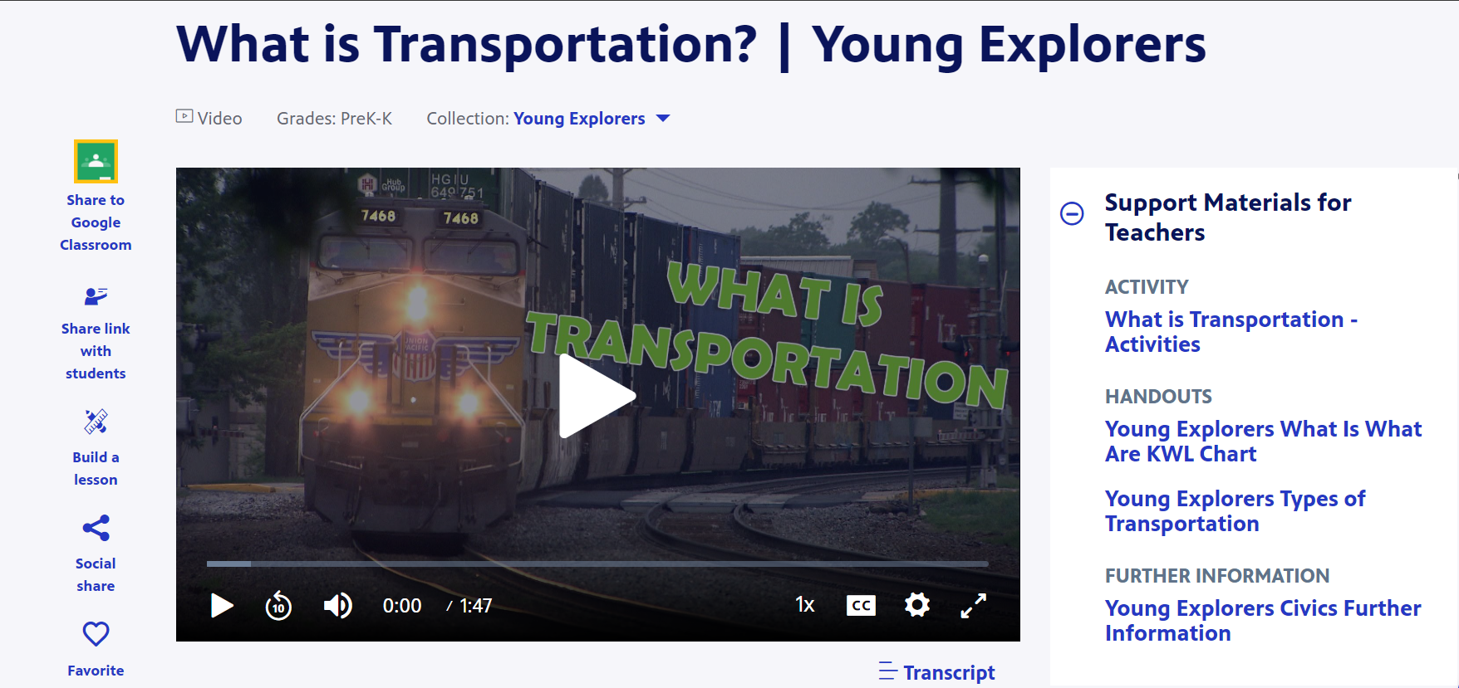
Strategies for Youth Engagement, continued
Examples:
What is Transportation? | Young Explorers | PBS LearningMedia

Slide 21
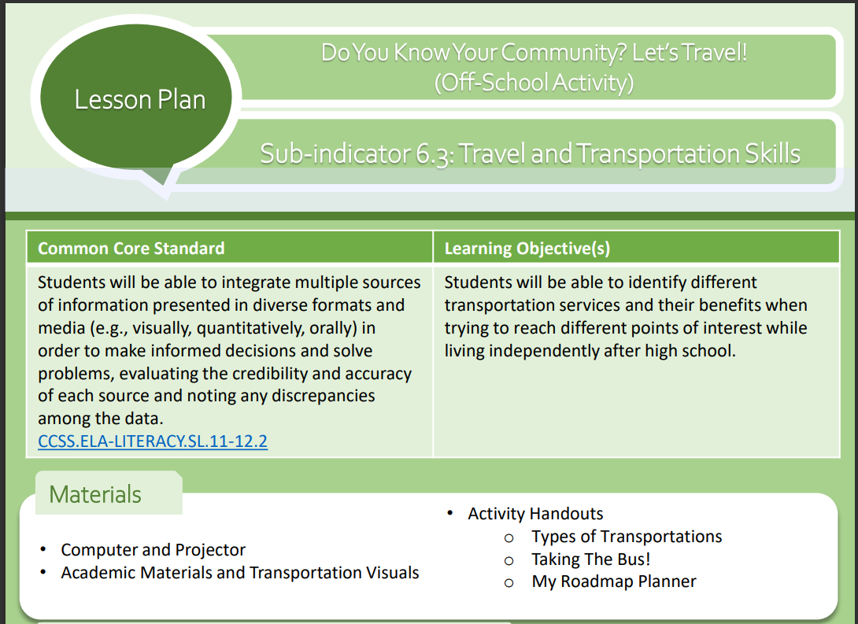
Strategies for Youth Engagement, continued
Examples:
TD Lesson Plan 6.3

Slide 22

Strategies for Youth Engagement, continued
Examples:
Safe Youth Transportation Solution

Slide 23
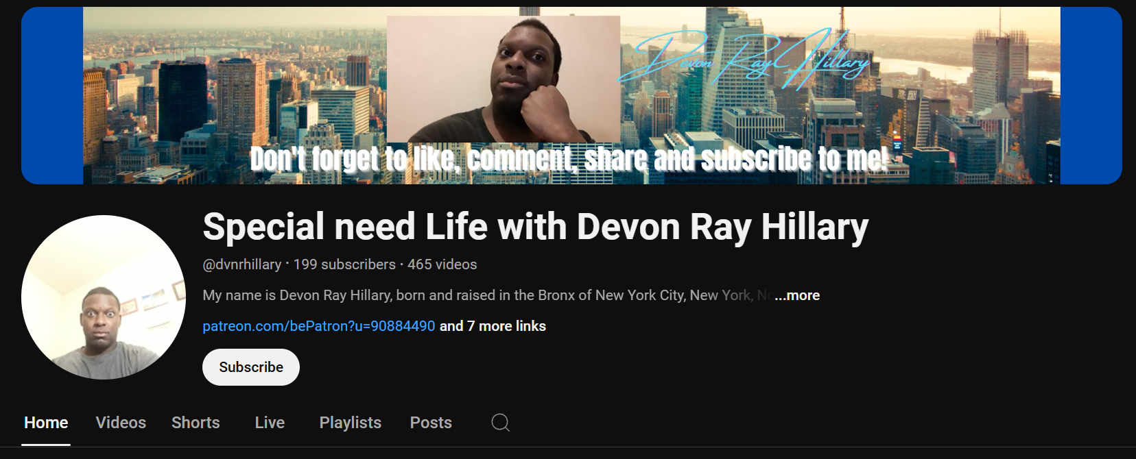
Strategies for Youth Engagement, continued
Examples:
Taking Public Transit Independently

Slide 24
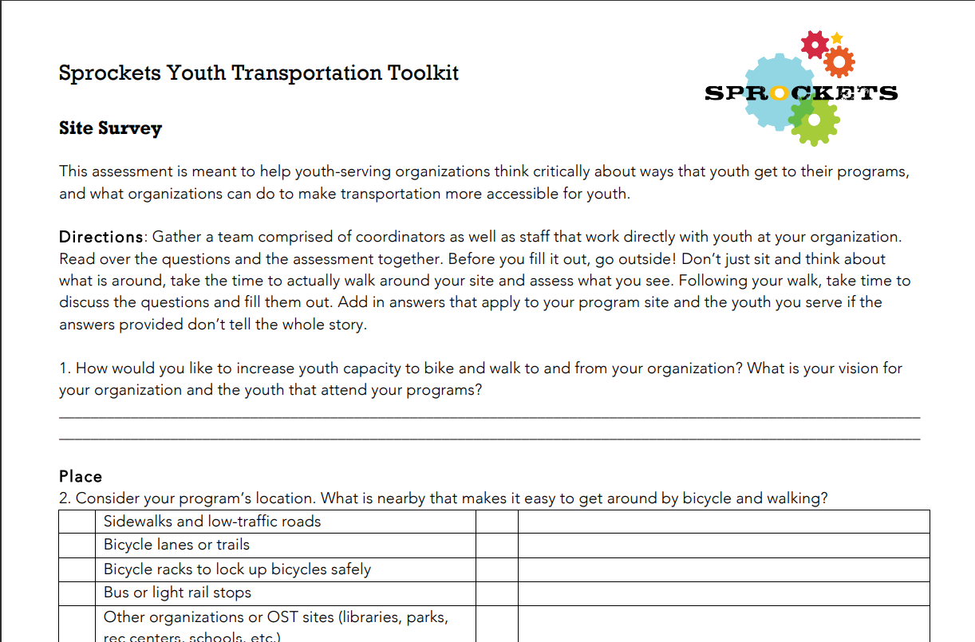
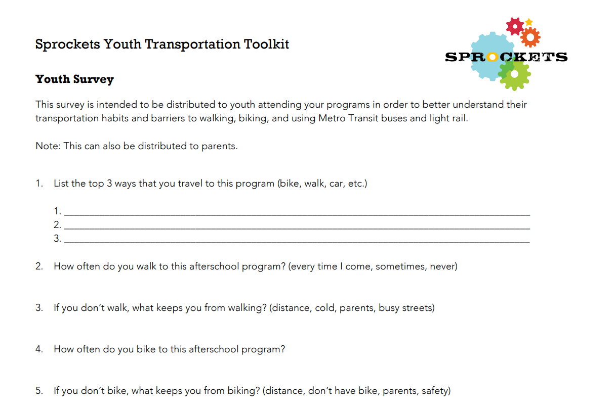
Strategies for Youth Engagement, continued
Examples:
Sprockets Youth Transportation Toolkit.docx

Slide 25
Youth On the Move: Transportation Advocacy & Mobility Management
There is a disparity between youth interest and youth involvement
Guidebook is a practical starting point for other regional guides
YOU have the power to create change and make a difference in the lives of youth

Slide 26
Youth On the Move: Transportation Advocacy & Mobility Management
Share YOUR knowledge!
What resources or best practices do you know that we haven’t highlighted today?

Slide 27
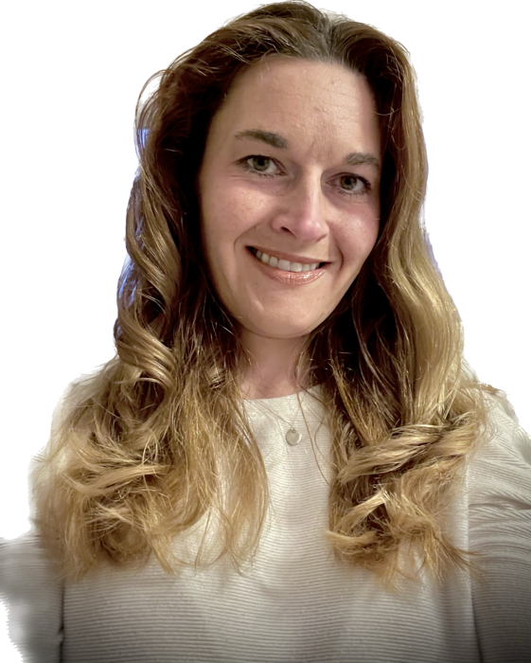
Speakers: Yvonne Phillips
Yvonne began career with the Chester County Intermediate Unit in 2015, transitioning into the role of travel trainer in 2017.
She has spent her career working with individual with multiple disabilities, Mental health impairments, economic disadvantages and as a First Aid and CPR instructor.
Throughout her career she kept seeing a common theme. People were less able to access employment and navigate their community due to a lack of awareness of the transit resources available, a fear and/or lack of the skills needed to successfully plan for and access public transportation.
Yvonne has a passion teach individuals the skills needed travel in the community, access employment, medical care and community services without relying on a ride or the assistance of a companion.
When she heard that the CCIU was expanding their travel trainer program and opening a position, it immediately sparked her interest.
She has obtained her Travel Trainer certification in 2018, is a board member and committee member of the Association for Travel Instruction and volunteer for a young adult social group for individuals with disabilities.

Slide 28
Youth On the Move: Transportation Advocacy & Mobility Management
Who we serve:
The Chester County Intermediate Unit provides services to the 12 school districts in Chester County. This includes services to nearly 86,000 public and non-public school students and over 6,000 educators.
CCIU's major services include: special education and compensatory education programs; career, technical and customized education; mentor training and staff development; technology initiatives; consortia for school business operations; and curriculum services.
  Mission: The Chester County Intermediate Unit is a dynamic educational service agency providing high-quality, innovative, and cost-effective programs and services to enhance the lives of learners, educators, and members of our communities.
  Vision: Educational leadership for a better Chester County and beyond.

Slide 29

Youth On the Move: Transportation Advocacy & Mobility Management
The Chester County Intermediate Unit’s is a regional educational agency developed through State law enactment in 1971
Our travel training program serves students with special needs, referred for service by the 12 Chester County school districts
Most travel trainees are 14-22 years of age
Students who receive local educational services and come from the surrounding counties of Montgomery, Berks, Delaware, Lancaster and Philadelphia
Individual and group instruction to the CCIU managed programs such as the, Transitional Work Program, ASPIRE program, Transitional Work Readiness Program and Transitional Living Program

Slide 30
Youth On the Move: Transportation Advocacy & Mobility Management
Trainee success is dependent up goal setting, analyzing home community, needs, wants, identifying current skill set and presuming competence
Prior to receiving instruction each trainee partakes in a 6-hour interview and evaluation.
The components of the evaluation include:
  Community safety preparedness, safety awareness, way-finding skills, mass transit planning and riding, money skills, number patterns, directory and map skills and route analysis of their home community
  Following the evaluation a travel plan with recommendations is presented to the student’s educational team, family and future trainee

Slide 31
Youth On the Move: Transportation Advocacy & Mobility Management
What instruction looks like…..
  Group Instruction includes supporting the life skills teacher’s community instruction component of the curriculum
    This may include identifying pedestrian and public transit travel routes to shopping, living, medical and government services
  Individual instruction may include teaching a route to home, work (paid or career exploration), shopping or areas of leisure
    Level of support is dependent upon skills set
    Fading occurs as trainee demonstrates skill competence
    Instruction may end once the goal is met or a new goal is identified

Slide 32
Youth On the Move: Transportation Advocacy & Mobility Management
The CCIU travel training program has measured success of following past trainees who continued to utilize mass-transit including bus, rail and light rail, para-transit and pedestrian routes.
  Some locations which past trainees travel to independently include; work, post-secondary educational institutions, vocational programs, shopping, libraries, medical appointments and leisure activities
  We assist trainees in obtaining a reduced fare pass to make travel more affordable
  Some past trainees with the greatest gains are those who said that they would never ride a bus or train and are now a piece of the population utilizing mass-transit

Slide 33
Youth On the Move: Transportation Advocacy & Mobility Management
At the CCIU we have discovered that it takes a team effort to obtain the highest level of success.
  Some additional factors that determine success include trust, understanding and at times empathy
  Trainees need to be heard and listened to, once a connection is established, buy-in is observed
  Oftentimes these trainees are the ones who become vocal about the need to improve sidewalks, signaled crossings and transit options
  With time, effective instructional approaches and effort independent travel is possible

Slide 34


Slide 35







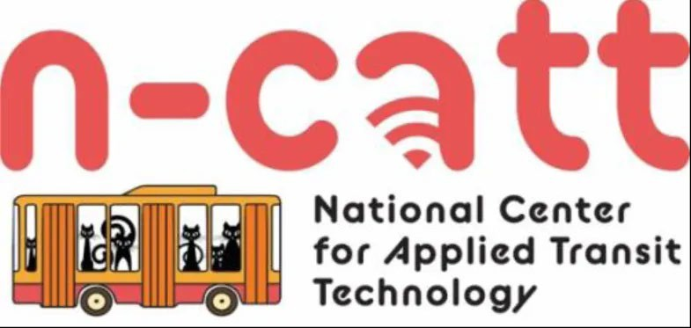
Technical Assistance (TA) Centers
National Center for Mobility Management www.nc4mm.org 1-866-846-6400 info@nc4mm.org Annual Community Grants
National Aging and Disability Transportation Center www.nadtc.org 1-866-983-3222
contact@nadtc.org Annual Community Grants
Rural Transit Assistance Program www.nationalrtap.org 1-888-589-6821 info@nationalrtap.org
Shared-Use Mobility Center www.sharedusemobilitycenter.org 1-312-448-8083 info@sharedusemobilitycenter.org
National Center for Applied Transit Technology www.ctaa.org/about-n-catt/
46

