Slide 1



CCAM Technical Assistance Center Webinar:
Introduction to
You Get What You Measure
Bill Wagner, CCAM Technical Assistance Center
Melissa Levy, Community Roots
Shanna Ratner, Yellow Wood Associates
Notes:
Bill

Slide 2
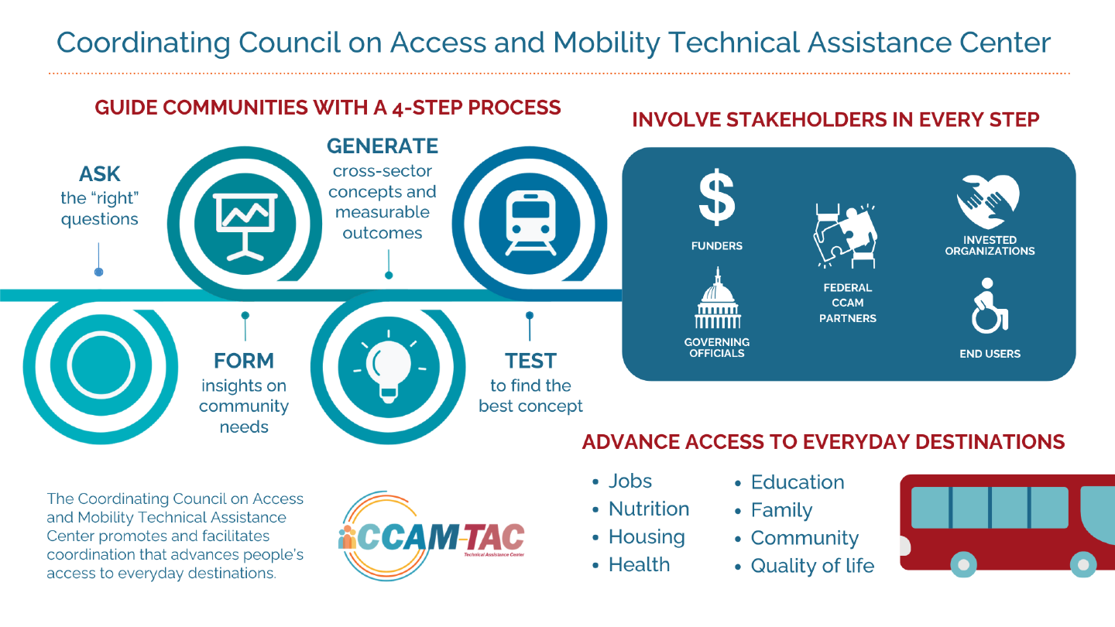
Notes:
Bill

Slide 3
AGENDA
Review the consultants’ scope of work
Review human centered design process
Present draft of CCAM-TAC goals (reframed)
Provide Overview of You Get What You Measure
Present some ideas for integrating human centered design process and YGWYM
GOAL: We have an integrated process for CCAM-TAC that we have co-created that results in outcome measures that matter.
Notes:
Shanna

Slide 4
SCOPE OF CONSULTANT’s WORK
Integrate evaluation, measurement and a focus on outcomes into the process of CCAM-TAC project design from the start.
Support this integration through training, curriculum development, capacity building and coaching with CCAM-TAC, grantees, etc.
Develop reporting tools and schedule.
Evaluate/measure the success of CCAM-TAC TA.
Notes:
Shanna

Slide 5

Human Centered Design Process
Planning Grants
  Select/articulate a challenge area
  Create a focus question
  Define target population and community
  Develop a multi-stakeholder team
  Conduct primary and secondary research
  Make sense of the research
  Generate 3 solution concepts and fine tune
  Test assumptions in the field
  Develop and present team pitch
Notes:
Bill

Slide 6

Human-Centered Design Process
Pilot Grants - Based on completing human-centered design planning process
CCAM-TAC facilitator:
  Assists in coordinating with federal & other partners
  Helps identify missing information
  Helps develop performance metrics
  Provides ongoing support and resources
Notes:
Bill

Slide 7
Human Centered Design
You Get What You Measure
Wonderful job of reaching out into the community to test key assumptions
Adds a focus on goals, a process for deriving key leverage indicators, and a process to identify measurable outcomes. Also clarifies actions required to reach the goals.
Focused on practical, measurable outcomes.
Focused on practical, measurable outcomes.
Bring in multiple perspectives from the start
Bring in multiple perspectives from the start
We expect the combination to provide a powerful method for identifying, connecting, and deploying a full range of partners and resources required to make change that lasts.
Notes:
Shanna Human-centered design is a problem-solving technique that puts real people at the center of the development process, enabling you to create products and services that resonate and are tailored to your audience’s needs.
The goal is to keep users’ wants, pain points, and preferences front of mind during every phase of the process.

Slide 8
You Get What You Measure:
A values-based approach to strategic planning and measurement
Notes:
Shanna

Slide 9
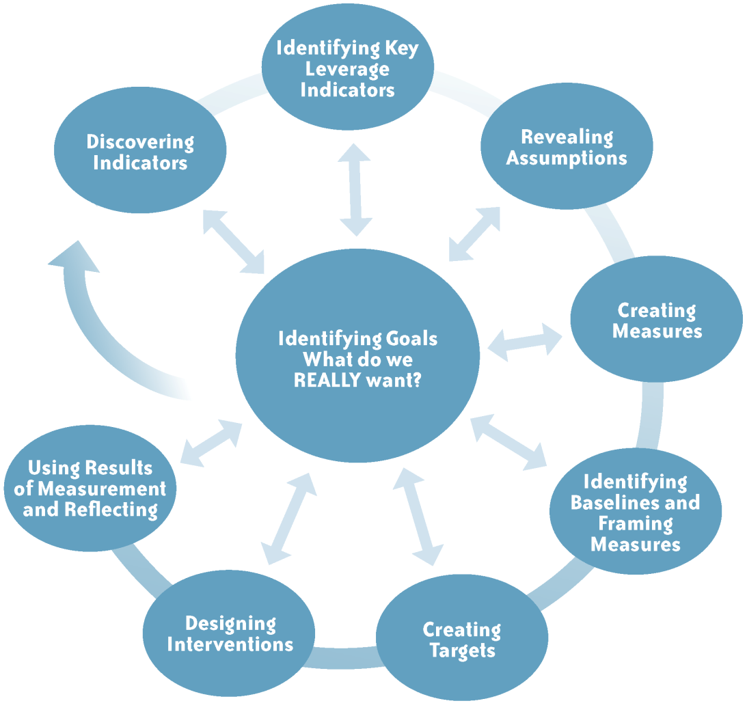
Process Overview
Notes:
Shanna
Linking Goals with Values
Identifying Key Leverage and Key Results Indicators
Developing a Measurement Plan
Taking Action
Goals which are built on “participants” values
(3 types of stakeholders need to be involved)
Those whose cooperation is absolutely essential to reaching the goal
Those in a position to prevent the organization from reaching the goal
Those who will be affected as the organization makes progress towards its goal, but whose cooperation is not essential
Note: Everyone has a voice in articulating values, selecting themes, creating goals, and identifying indicators that would demonstrate real progress toward meeting the goal.

Slide 10
It Starts with Goals:
From Activities to Conditions
An Example from CCAM-TAC
Original activity:
Enhance safe, accessible, and equitable transportation options aligned with the CCAM-TAC through regional, state, and local coordination and strategic partnerships.
Actively engage CCAM-TAC members, Federal agencies, their grantees, partners, and stakeholders to emphasize the important role of transportation in access to services and everyday destinations, and to provide technical assistance to reduce barriers to human services transportation coordination.
Reframed goal:
Access to economic opportunity, health-related destinations, community and peer support and determinants of health is improved for specific target populations.
Cross-sector partnerships that support mobility solutions are created and maintained.
Notes:
Shanna – It’s not what you do; it’s what happens as a result of what you do that matters.

Slide 11

Draft External Goals for CCAM-TAC
Access to economic opportunity, health-related destinations, community and peer support and determinants of health is improved for specific target populations.
Human-centered design process is used to determine implementation choices.
Cross-sector partnerships that support mobility solutions are created and maintained.
Quality of life of riders is improved through access to transportation. Outcomes of mobility solutions are measured and framed – benefits to users and other beneficiaries are captured.
Investors recognize their self-interests in investing in improving transportation access. Mobility solutions are financially sustainable.
Notes:
Shanna
Explain about activities versus conditions and the use of the present tense. Explain what an external goal is

Slide 12

Draft Internal Goals
      Federal agencies, Regional, state departments of Medicaid and Transportation, and local resources are actively coordinated with local resources to achieve goals.
        3 levels of success with federal agencies
          They contract with CCAM-TAC to meet needs of their constituents
          They announce CCAM-TAC RFPs on their websites
          They contribute resources to specific CCAM-TAC projects – one offs
      Models, examples, best practices, and guidance are provided to agencies and communities regarding available transportation resources and funding. Resources are available to conduct customized research using new transportation related data, strategies, or insights.
      CCAM-TAC staff and partners are equipped to provide effective technical assistance to grantees, their partners and stakeholders. Tools and training is available - Cost allocation tools, data-based policy map and community provider map – tools to be provided with training.
      A phased process including planning and implementation grants is used to identify viable solutions.
      The exchange of timely and relevant information among transportation activists at all levels is supported.
Notes:
Shanna – explain what an internal goal is

Slide 13
Case Study
An example of YGWYM in action from a rural agricultural community struggling with development pressure.
The work is conducted by a multi-stakeholder group. Each person brings a different perspective and different knowledge and experience to the table. All are equally valued and everyone participates.
Notes:
MElissa

Slide 14
It Starts with Goals
There are viable agricultural enterprises in Our Town.
Notes:
Melissa
Notice the goal is broad and does not indicate anything about how it will be achieved.

Slide 15

Indicators of Progress
How will you know we are making progress toward this goal? What needs to change?
From the perspective of each of the constituents represented in the room, what would positive change toward this goal look like?
Notes:
Melissa
Not groupthink. People thinking about what matters to them and people like them. Different for every person in the room.

Slide 16
#1: More ag-related enterprises are present, visible and growing in our community.
#10: More coordinated supportive services and complementary agricultural services/enterprises
#2: The land resources necessary to attract, and keep, agricultural enterprises in Our Town are available and affordable.
#9: Prioritize existing farmland or farmland preservation
#3: Better understanding of agricultural issues by municipal employees, elected officials, and Town committees and commissions.
#8: Tax equality for all agricultural enterprises
#7: The number of functional farms in Our Town remains the same or increases.
#4: Producers and residents share the identify of Our Town as an agriculture community.
#6: High-level of commitment from University to Our Town’s vision and agriculture strategy.
#5: Our Town is realistically (viable) attractive as a place to farm.
Notes:
Melissa
These are indicators that show what evidence of the goal looks like from the perspective… showing you what happens.

Slide 17
#1: More ag-related enterprises are present, visible and growing in our community.
#10: More coordinated supportive services and complementary agricultural services/enterprises
#2: The land resources necessary to attract, and keep, agricultural enterprises in Our Town are available and affordable.
#9: Prioritize existing farmland or farmland preservation
#3: Better understanding of agricultural issues by municipal employees, elected officials, and Town committees and commissions.
What does it mean?
#8: Tax equality for all agricultural enterprises
#7: The number of functional farms in Our Town remains the same or increases.
#4: Producers and residents share the identify of Our Town as an agriculture community.
#6: High-level of commitment from University to Our Town’s vision and agriculture strategy.
#5: Our Town is realistically (viable) attractive as a place to farm.
Notes:
Melissa

Slide 18
Key Leverage Indicators
#1: More ag-related enterprises are present, visible and growing in our community.
#10: More coordinated supportive services and complementary agricultural services/enterprises
#2: The land resources necessary to attract, and keep, agricultural enterprises in Our Town are available and affordable.
#9: Prioritize existing farmland or farmland preservation
#3: Better understanding of agricultural issues by municipal employees, elected officials, and Town committees and commissions.
#3: Better understanding of agricultural issues by municipal employees, elected officials, and Town committees and commissions.
KLI #1
#8: Tax equality for all agricultural enterprises
#7: The number of functional farms in Our Town remains the same or increases.
#4: Producers and residents share the identify of Our Town as an agriculture community.
#4: Producers and residents share the identify of Our Town as an agriculture community.
KLI #2
#6: High-level of commitment from University to Our Town’s vision and agriculture strategy.
#5: Our Town is realistically (viable) attractive as a place to farm.
Notes:
Melissa

Slide 19
Key Leverage Indicator #1
#1: More ag-related enterprises are present, visible and growing in our community.
#10: More coordinated supportive services and complementary agricultural services/enterprises
#2: The land resources necessary to attract, and keep, agricultural enterprises in Our Town are available and affordable.
#9: Prioritize existing farmland or farmland preservation
#3: Better understanding of agricultural issues by municipal employees, elected officials, and Town committees and commissions.
#8: Tax equality for all agricultural enterprises
#7: The number of functional farms in Our Town remains the same or increases.
#4: Producers and residents share the identify of Our Town as an agriculture community.
#6: High-level of commitment from University to Our Town’s vision and agriculture strategy.
#5: Our Town is realistically (viable) attractive as a place to farm.
Notes:
Melissa

Slide 20
Key Leverage Indicator #2
#1: More ag-related enterprises are present, visible and growing in our community.
#10: More coordinated supportive services and complementary agricultural services/enterprises
#2: The land resources necessary to attract, and keep, agricultural enterprises in Our Town are available and affordable.
#9: Prioritize existing farmland or farmland preservation
#3: Better understanding of agricultural issues by municipal employees, elected officials, and Town committees and commissions.
#8: Tax equality for all agricultural enterprises
#7: The number of functional farms in Our Town remains the same or increases.
#4: Producers and residents share the identity of Our Town as an agriculture community.
#4: Producers and residents share the identify of Our Town as an agriculture community.
#6: High-level of commitment from University to Our Town’s vision and agriculture strategy.
#5: Our Town is realistically (viable) attractive as a place to farm.
Notes:
Melissa

Slide 21
Key Results Indicator
#1: More ag-related enterprises are present, visible and growing in our community.
#10: More coordinated supportive services and complementary agricultural services/enterprises
#2: The land resources necessary to attract, and keep, agricultural enterprises in Our Town are available and affordable.
#9: Prioritize existing farmland or farmland preservation
#3: Better understanding of agricultural issues by municipal employees, elected officials, and Town committees and commissions.
#8: Tax equality for all agricultural enterprises
#7: The number of functional farms in Our Town remains the same or increases.
#7: The number of functional farms in Our Town remains the same or increases.
#4: Producers and residents share the identify of Our Town as an agriculture community.
#6: High-level of commitment from University to Our Town’s vision and agriculture strategy.
#5: Our Town is realistically (viable) attractive as a place to farm.
Notes:
MElissa

Slide 22
Key Results Indicator
#1: More ag-related enterprises are present, visible and growing in our community.
#10: More coordinated supportive services and complementary agricultural services/enterprises
#2: The land resources necessary to attract, and keep, agricultural enterprises in Our Town are available and affordable.
#9: Prioritize existing farmland or farmland preservation
#3: Better understanding of agricultural issues by municipal employees, elected officials, and Town committees and commissions.
#8: Tax equality for all agricultural enterprises
#7: The number of functional farms in Our Town remains the same or increases.
#4: Producers and residents share the identify of Our Town as an agriculture community.
#5: Our Town is realistically (viable) attractive as a place to farm.
#6: High-level of commitment from University to Our Town’s vision and agriculture strategy.
Notes:
Melissa

Slide 23
How to Develop Measures
Discuss how you will define the terms in your goal and key leverage indicator(s).
Determine the unit of measure
Identify the relevant baseline and how you will establish it
Notes:
Shanna
We will be providing training on all of this.

Slide 24
Key Indicator:
Better understanding of agricultural issues by municipal employees, elected officials, and Town committees and commissions.
Definitions:
Agricultural issues Which issues are most salient to the goal at this point for this community?
Purchases from local farms by public and private institutions and individuals
Raise visibility of Our Town as an agricultural community
Protect agricultural lands in small and large parcels
Allow for self-provisioning activities including gardens, community gardens, edible landscaping, chickens.
Employ local youth employment on local farms
Include Farmers in local municipal decision-making
Municipal employees - Town clerk, town planner, town administrator, road crew
Elected Officials - County representatives, Selectboard members, School Board members
Town Committees and Commissions - Planning Committee, Zoning Committee, Recreation Committee, Fundraising Committee
Better understanding
Farmers are present or otherwise invited to voice their perspectives in discussions of municipal issues.
Impacts on local agriculture and agricultural land use are considered and documented in every policy decision.
Actions taken support one or more the agricultural issues.
Notes:
Shanna

Slide 25
Key Indicator:
Better understanding of agricultural issues by municipal employees, elected officials, and Town committees and commissions.
Measures
Unit of Measure: The number of policies passed and other actions taken by municipal employees, elected officials, town committees and/or commissions that document impact on one or more of the identified agricultural issues over a calendar year.
Baseline: The number of policies passed and other actions taken by municipal employees, elected officials, town committees and/o commissions that document the impact on one or more of the identified agricultural issues over the past three years.
Notes:
Shanna

Slide 26
Framing Measures: Based on Research
Framing measures illustrate the entire scope of the opportunity; targets identify the focus of your actions and what is possible and help define success; measures tell you if you are making progress toward your targets.
Framing measures have three elements:
1. A geographic frame
2. A time frame (that allows you to see trends over time)
3. A plausible target (based on research into conditions in similar areas)
Notes:
Shanna
Look outside themselves to see what’s possible.

Slide 27
Example of a Framing Measure related to the Case Study
Framing measure: Identify towns within the state that are demonstrating support for local agriculture.
  What have they accomplished in relation to each issue area?
  How can you use their experience to set targets for this town?
  Note: this may lead to refined measures related to specific issues.
Notes:
Shanna

Slide 28
Action Plans and Measurement Plans
Action plans answer the question: What do we need to do to move our key leverage indicators in a positive direction?
Measurement plans answer the question: How are we going to know if we're making progress?
Notes:
Shanna

Slide 29
Possibilities for Integration of HCD and YGWYM in Planning
Select/articulate a challenge area
Create a focus question and a goal
Define target population and community
Develop a multi-stakeholder team
Conduct primary and secondary research
Make sense of the research
Generate 3 solution concepts/action plans
Select most promising concept solution.
Test assumptions in the field
Apply YGWYM – restate the goal, indicators, analysis, definitions, baseline measures
Develop and present team pitch
Notes:
Shanna

Slide 30
Possibilities for Integration of HCD and YGWYM in Implementation
Based on completing human centered design planning process
CCAM-TAC facilitator:
  Assists in coordinating with federal & other partners
  Helps identify missing information
  Build on indicator analysis focused on solution concept and related goals
  Review definitions of key leverage indicators and measures.
  Finetune measures and measurement plans.
  Implement measurement plans.
  Develop and implement action plans
  Develop baseline and framing measures and remeasurement plan
  Provides ongoing support and resources
Notes:
Shanna

Slide 31
Discussion: Next Steps
  Q&A about YGWYM
  Q&A about preliminary ideas for integration
  Other
  Next steps – plan for workshop in June and more extensive trainings beyond.
Notes:
Shanna

Slide 32

You Get What You Measure - Resources
Progress You Can See book
YouTube videos
https://youtu.be/VNCd2pCtdgI?si=goSv346JmA8yVjnk
https://youtu.be/DCQA6XcBp6o?si=OXtSUo-uKlTiCuSk
Brochure - https://yellowwood.org/assets/resource_library/resource_docs/ygwymbooklet041411web.pdf
Notes:
Shanna

